Slide 1

Web Development Lecture 03
Mr. Niaz Mir Khan
Lecturer in Computer Science
__________________________________________________
Department of Computer Science
Govt: Degree College Jamrud, District Khyber

Slide 2
Basic HTML tables
<table></table>: create a table
<tr></tr>: create a table row
<td></td>: create tabular data (cell)
TABLE element
Attributes
BORDER lets you set the width of the table’s border in pixels
ALIGN: left, right or center
WIDTH: pixels (absolute) or a percentage
CAPTION element is inserted directly above the table in the browser window

Slide 3
Basic HTML tables
TABLE element (cont.)
THEAD element
Header info
For example, titles of table and column headers
TR element
Table row element used for formatting the cells of individual rows
TBODY element
Used for formatting and grouping purposes
Smallest area of the table we are able to format is data cells
Two types of data cells
In the header: <TH>…</TH> suitable for titles and column headings
In the table body: <TD>…</TD>
Aligned left by default

Slide 4
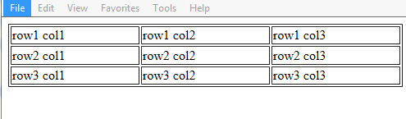
Example:
<table border=1 width="100%">
<tr>
<td>row1 col1</td>
<td>row1 col2</td>
<td>row1 col3</td>
</tr>
<tr>
<td>row2 col1</td>
<td>row2 col2</td>
<td>row2 col3</td>
</tr>
<tr>
<td>row3 col1</td>
<td>row3 col2</td>
<td>row3 col3</td>
</tr>
</table>

Slide 5
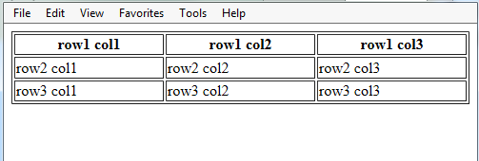
<th> instead of <td>
<table>
<tr>
<th>row1 col1</th>
<th>row1 col2</th>
<th>row1 col3</th></tr>
<tr><td>row2 col1</td>
<td>row2 col2</td>
<td>row2 col3</td></tr>
<tr>
<td>row3 col1</td>
<td>row3 col2</td>
<td>row3 col3</td></tr>
</table>

Slide 6
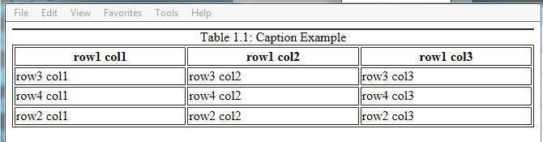
Example:
<table border=1 width="100%">
<caption>Table 1.1: Caption Example</caption>
<thead>
<tr><th>row1 col1</th>
<th>row1 col2</th>
<th>row1 col3</th></tr>
</thead>
<tfoot>
<tr><td>row2 col1</td>
<td>row2 col2</td>
<td>row2 col3</td> </tr>
</tfoot>
<tr><td>row3 col1</td>
<td>row3 col2</td>
<td>row3 col3</td></tr>
<tr><td>row4 col1</td>
<td>row4 col2</td>
<td>row4 col3</td></tr></table>
<thead><tfoot><caption>

Slide 7
Cell Spacing and Padding
Tables have two important attributes:
Cellspacing
Defines the empty space between cells
Cellpadding
Defines the empty space around the cell content
cell
cell
cell
cell
cell
cell
cell
cell

Slide 8
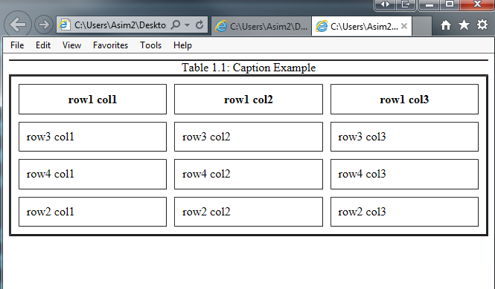
Example:
<table border=3 cellspacing="10" cellpadding="10" width="100%">
<caption>Table 1.1: Caption Example</caption>
<thead>
<tr><th>row1 col1</th>
<th>row1 col2</th>
<th>row1 col3</th> </tr>
</thead>
<tfoot>
<tr><td>row2 col1</td>
<td>row2 col2</td>
<td>row2 col3</td></tr>
</tfoot>
<tr><td>row3 col1</td>
<td>row3 col2</td>
<td>row3 col3</td></tr>
<tr><td>row4 col1</td>
<td>row4 col2</td>
<td>row4 col3</td>
</tr></table>

